Slide 1
UNIT-III
Modules and packages

Slide 2
Modules:
A module is a file containing Python definitions and statements. The file name is the module name with the suffix.py appended. For instance, use your favourite text editor to create a file called fibo.py in the current directory with the following contents:
# Fibonacci numbers module
def fib(n): # write Fibonacci series up to n
a, b = 0, 1
while b < n:
print b,
a, b = b, a+b
def fib2(n): # return Fibonacci series up to n
result = []
a, b = 0, 1
while b < n:
result.append(b)
a, b = b, a+b
return result

Slide 3
Now enter the Python interpreter and import this module with the following command:
>>> import fibo
This does not enter the names of the functions defined in fibo directly in the current symbol table; it only enters the module name fibo there. Using the module name you can access the functions:
>>> fibo.fib(1000)
1 1 2 3 5 8 13 21 34 55 89 144 233 377 610 987
>>> fibo.fib2(100)
[1, 1, 2, 3, 5, 8, 13, 21, 34, 55, 89]
>>> fibo. name
'fibo'

Slide 4
from statement:
A module can contain executable statements as well as function definitions. These statements are intended to initialize the module. They are executed only the first time the module name is encountered in an import statement.
>>> from fibo import fib, fib2
>>> fib(500)
1 1 2 3 5 8 13 21 34 55 89 144 233 377
This does not introduce the module name from which the imports are taken in the local symbol table (so in the example, fibo is not defined).
There is even a variant to import all names that a module defines:
>>> from fibo import *
>>> fib(500)
1 1 2 3 5 8 13 21 34 55 89 144 233 377

Slide 5
Namespaces and Scoping
  A namespace is a dictionary of variable names (keys) and their corresponding objects (values).
  A Python statement can access variables in a local namespace and in the global namespace. If a local and a global variable have the same name, the local variable shadows the global variable.
  Each function has its own local namespace. Class methods follow the same scoping rule as ordinary functions.
  Python makes educated guesses on whether variables are local or global. It assumes that any variable assigned a value in a function is local.
  Therefore, in order to assign a value to a global variable within a function, you must first use the global statement.
  The statement global VarName tells Python that VarName is a global variable. Python stops searching the local namespace for the variable.
  For example, we define a variable Money in the global namespace. Within the functionMoney, we assign Money a value, therefore Python assumes Money as a local
variable. However, we accessed the value of the local variable Money before setting it, so an UnboundLocalError is the result. Uncommenting the global statement fixes the problem.

Slide 6
Packages in Python
A package is a hierarchical file directory structure that defines a single Python
application environment that consists of modules and subpackages and subsubpackages, and so on.
Third Party Packages:
The Python has got the greatest community for creating great python packages. There
are more tha 1,00,000 Packages available at https://pypi.python.org/pypi .
Python Package is a collection of all modules connected properly into one form and distributed PyPI, the Python Package Index maintains the list of Python packages available.
Now when you are done with pip setup Go to command prompt / terminal and say
pip install <package_name>
Note: In windows, pip file is in “Python27\Scripts” folder. To install package you have goto the path C:\Python27\Scripts in command prompt and install.
The requests and flask Packages are downloaded from internet. To download install the packages follow the commands
Installation of requests Package:
∝ Command: cd C:\Python27\Scripts
∝ Command: pip install requests
Installation of flask Package:
∝ Command: cd C:\Python27\Scripts
∝ Command: pip install flask
Example: Write a script that imports requests and fetch content from the page.
import requests
r = requests.get('https://www.google.com/')
print r.status_code
print r.headers['content-type']
print r.text

Slide 7
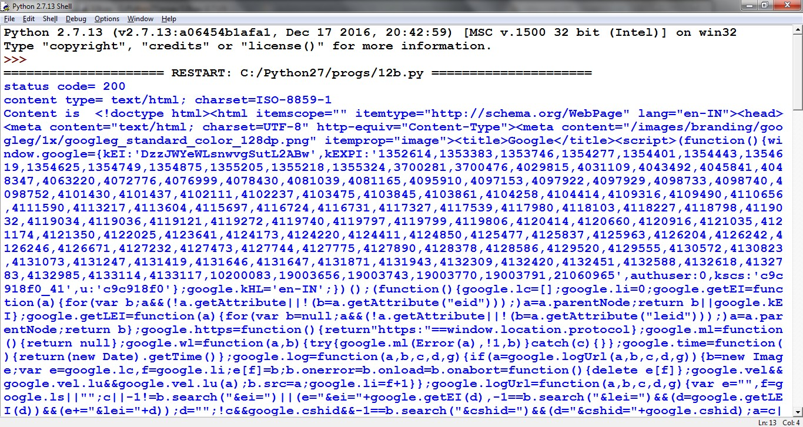

Slide 8
There are some libraries in python:
Requests: The most famous HTTP Library. It is a must and an essential criterion for every Python Developer.
Scrapy: If you are involved in webscripting then this is a must have library for you. After using this library you won‟t use any other.
Pillow: A friendly fork of PIL (Python Imaging Library). It is more user-friendly than PIL and is a must have for anyone who works with images.
SQLAchemy: It is a database library.
BeautifulSoup: This xml and html parsing library.
Twisted: The most important tool for any network application developer.
NumPy: It provides some advanced math functionalities to python.
SciPy: It is a library of algorithms and mathematical tools for python and has caused many scientists to switch from ruby to python.
Matplotlib: It is a numerical plotting library. It is very useful for any data scientist or any data analyzer.

Slide 9
A Quick Review of What Functions Are and How They Work
Functions as Abstraction Mechanisms
Functions Eliminate Redundancy
Functions Hide Complexity
Functions Support General Methods with Systematic Variations
Functions Support the Division of Labor

Slide 10
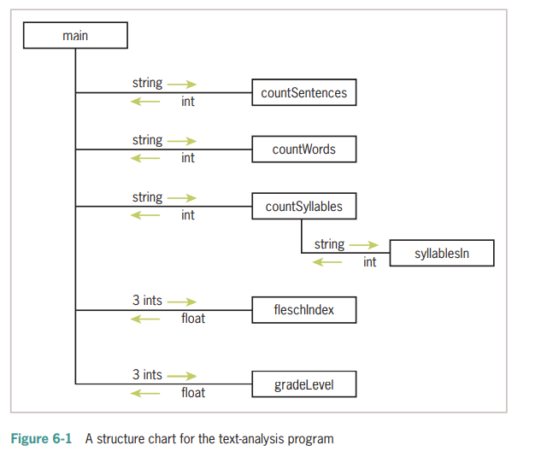
Problem Solving with Top-Down Design
The Design of the Text-Analysis Program

Slide 11
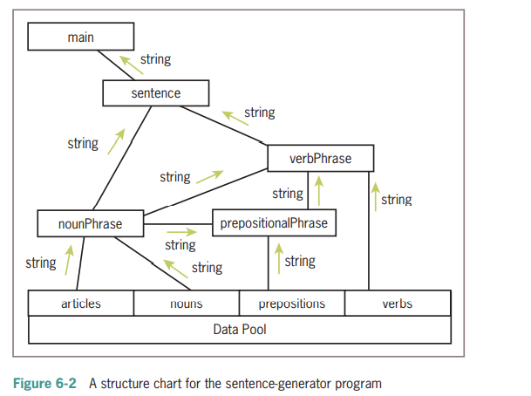
The Design of the Sentence-Generator Program

Slide 12
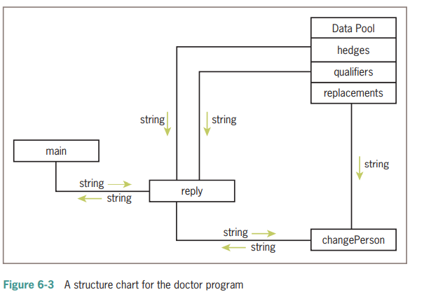
The Design of the Doctor Program

